Slide 1



Do you like watching TV? What’s your favorite program?
Why do you like it?

Slide 2
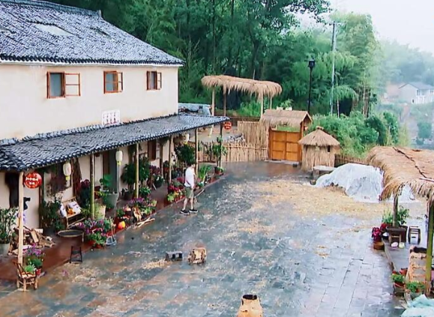
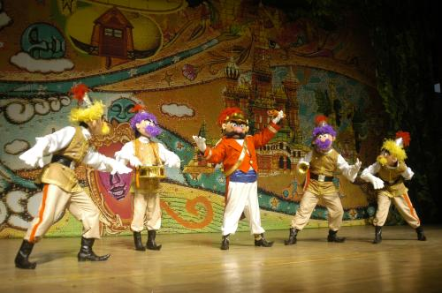
What do you think of outdoors reality shows?
I love outdoors reality shows. It’s really interesting.
What do you think of game shows?

Slide 3
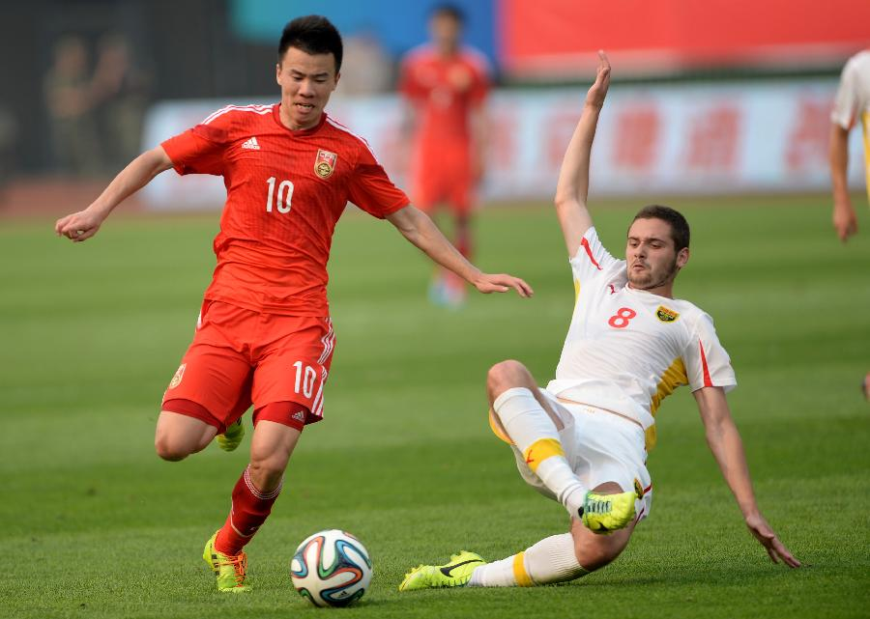
What do you think of soccer games?
I don’t mind them.
v. 介意；对(某事)烦恼

Slide 4
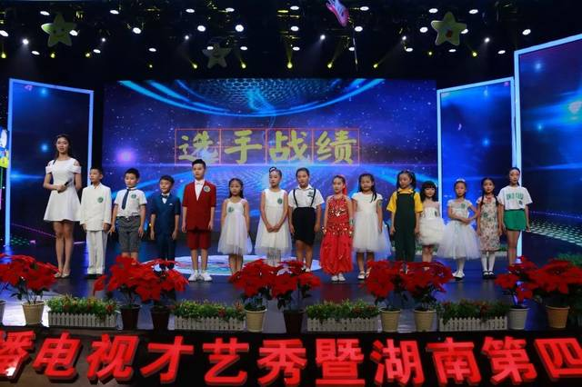
What do you think of talent shows?
I don’t like talent shows.
I can’t stand them.

Slide 5





What do/does sb. think of ...?
某人认为……怎么样？与How do/does sb. like ...?同义，询问对某事物或某人的观点或看法；
回答时可用love, like, don’t mind, don’t like, can’t stand等来表达对某事物或某人的好恶程度。
love
don’t mind
like
don’t like
can’t stand
e.g. —What do you think of soap operas?
(= How do you like soap operas?)
—I don’t mind them.

Slide 6


Listen again and answer the questions.
1. What does Mark plan to do later?
2. What does Jack think of talk shows?
3. Does Jack like the news?
He plans to watch TV.
He doesn’t mind them, but sometimes they can be a bit boring.
Yes, he does.

Slide 7
4. What does Jack think of talent shows?
5. Does Mark want to watch the soccer game at 5:00? How about Jack?
He usually can’t stand them, but the new one is quite funny.
Yes, he does. So does Jack.

Slide 8
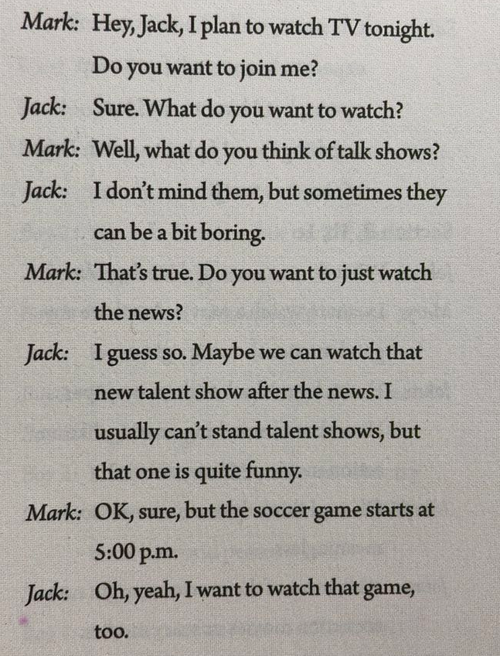
What do you think of…?
你觉得……怎么样？
脱口秀
我不介意它们。
I can’t stand ...
我无法忍受……
才艺秀
足球比赛

Slide 9

Unit 5

Slide 10
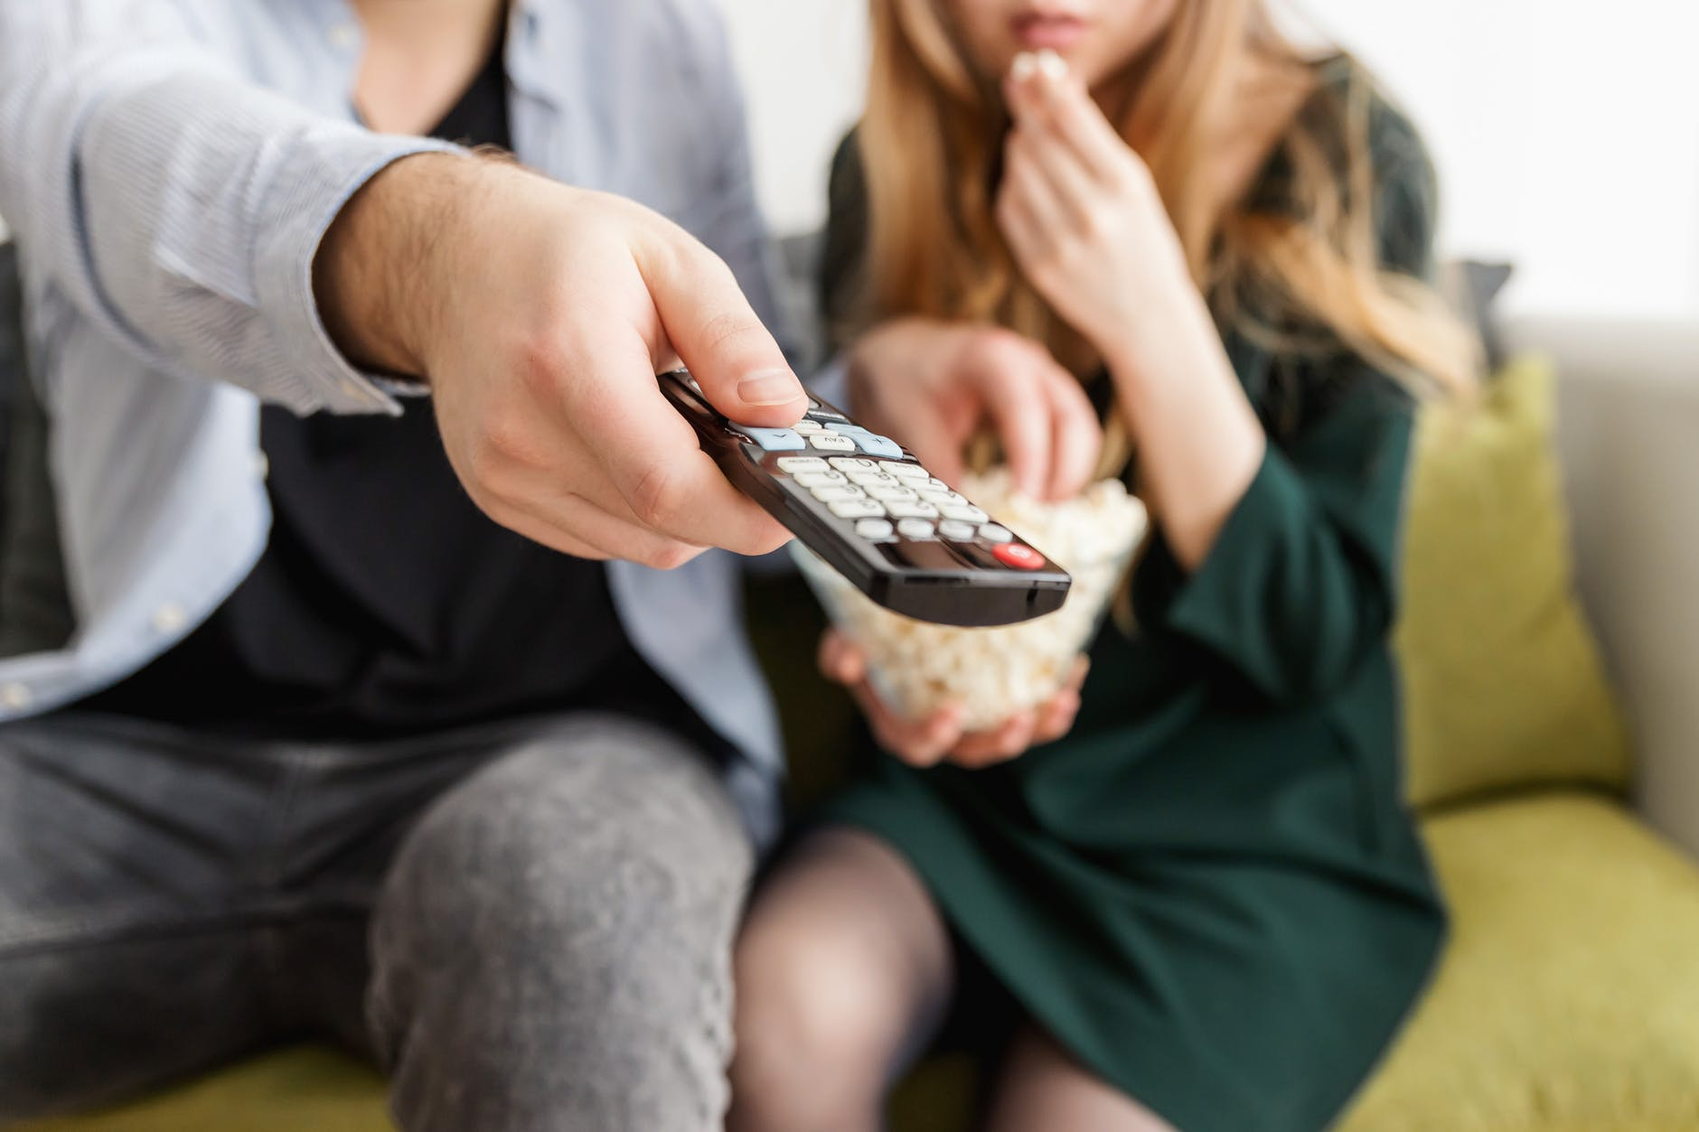
Unit 5
Do you want to
watch a game show?

Slide 11
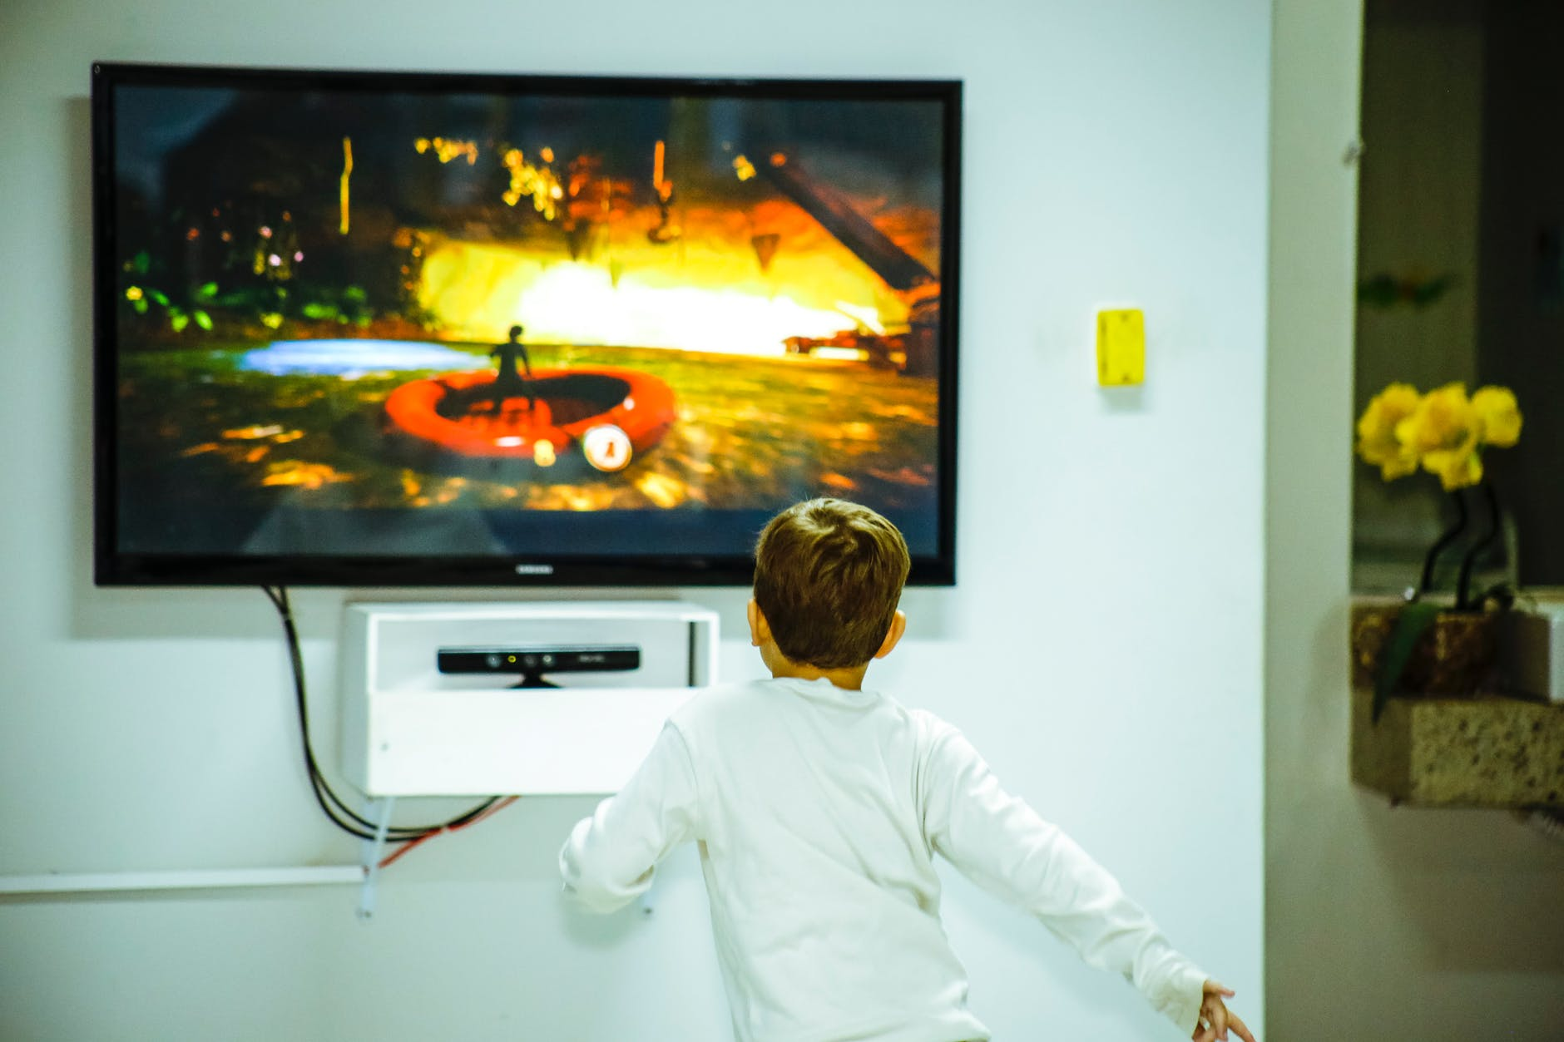


Slide 12


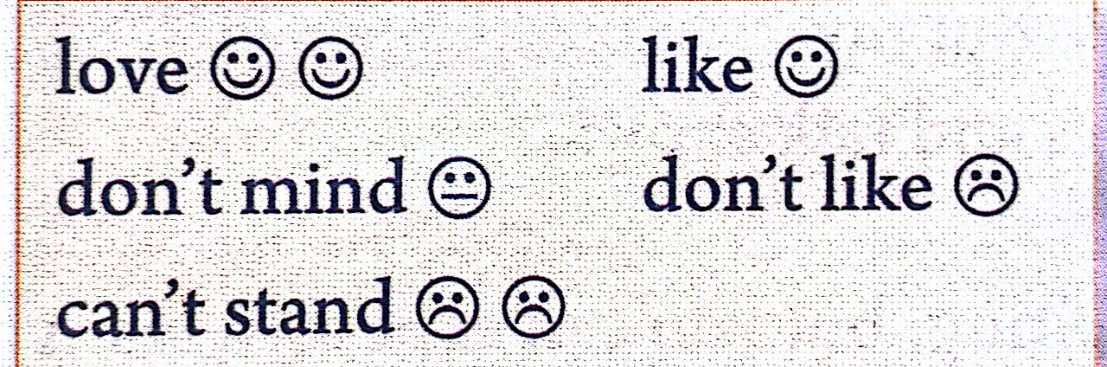



Lead in
What kind of TV show are they?
What do you think of them?
talent show 达人秀
v. 介意
v. 忍受;站立
China’s Got Talent
America's Got Talent
Britain’s Got Talent

Slide 13
Lead in
What other kinds of TV shows do you know?

Slide 14


sitcom(situation comedy): 情景喜剧 (通常让主要角色在固定的几个景点，过着自己的生活，而每集都有不同的主题，其中有爱情、友情和亲情等。)
A:What do you think of sitcoms?
B: I love them.
A:Why?
《爱情公寓》
B: Because they are funny and I can learn some jokes.
n. 笑话
plan v. 计划
A:Do you plan to watch them tonight?
B: Yes, I do.

Slide 15
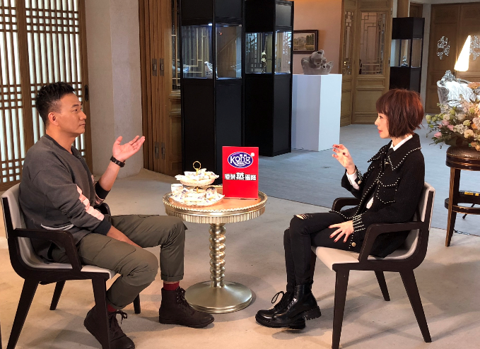
talk show 脱口秀/谈话节目
(一种由观众/嘉宾聚集在一起讨论主持人提出的话题的电视节目。)
A:What do you think of talk shows?
B: I can’t stand them.
A:Why?
B: Because they are so boring.
《鲁豫有约》
A:Do you want to watch them this weekend?
B: No, I don’t.

Slide 16

soap opera:肥皂剧
(以家庭问题为主要内容的连续剧。)
A:What do you think of soap operas?
B: I don’t mind them.
But you can’t expect to learn
much from them.
v. 期待；预料
《意难忘》
A:Do you plan to watch them this weekend?
B:No, I don’t.

Slide 17
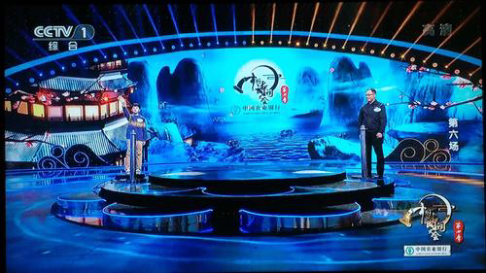
game show:竞赛节目/游戏节目
(选手们通过游戏/竞赛角逐奖项。)
A:What do you think of game shows?
B:I like them.
A:Why?
《中国诗词大会》
B:Because I can try to guess the answers to the questions.
A:Do you hope to watch them on TV?
v. 希望
B:Yes, I do.

Slide 18
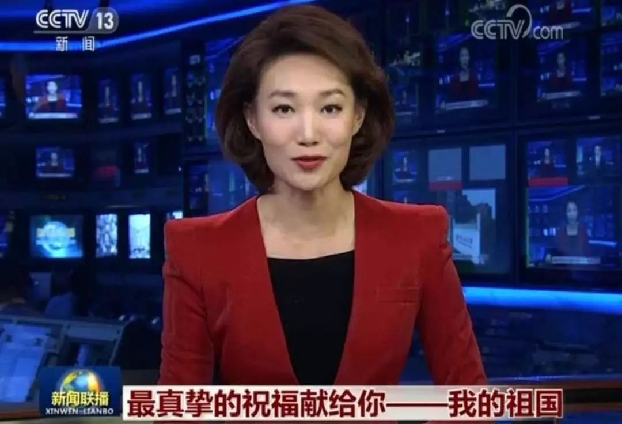
news: 新闻
A:What do you think of news?
B:I like it.
A:Why?
《新闻联播》
B:Because I can learn much from it and it is educational.
education n. 教育
A:What do you plan to watch tonight?
B:I plan to watch news.

Slide 19

TV shows
1. talk show ___
脱口秀/谈话节目
2. soap opera ___
肥皂剧
3. sports show ___
运动节目
4. sitcom ___
情景喜剧
5. game show ___
竞赛节目/游戏节目
6. talent show ___
达人秀
7. news ___
新闻
8. comedy show ___
喜剧表演

Slide 20
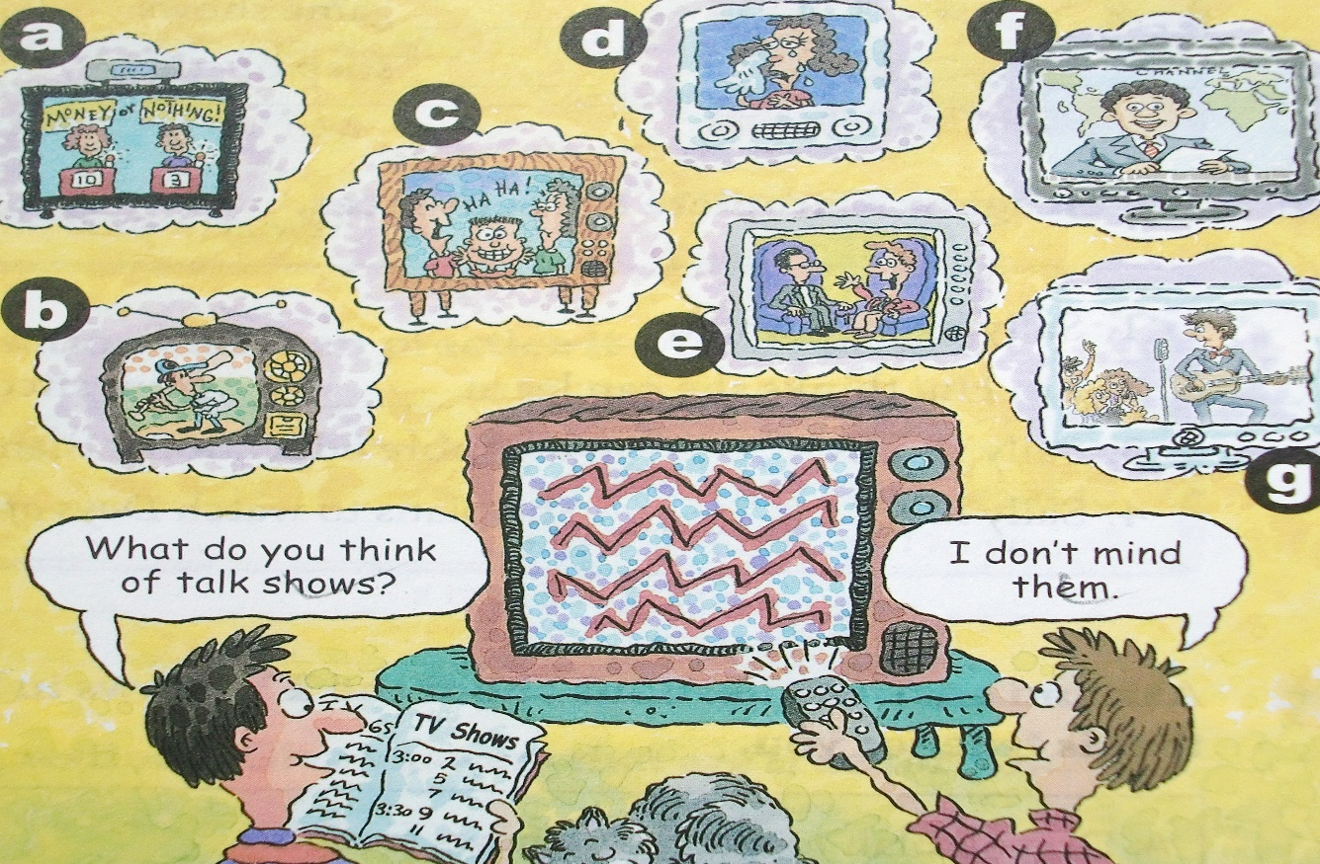
Match the TV shows with the pictures [a-g].
e
d
b
1. talk show ___ 2. soap opera ___ 3. sports show ___
4. sitcom ___ 5. game show ___ 6. talent show ___
7. news ___
c
a
g
f

Slide 21

Ask and Answer
—What kind of TV show is it?
—It’s ____________.
—What do you think of it?
—I __________ it.
news
don’t mind

Slide 22
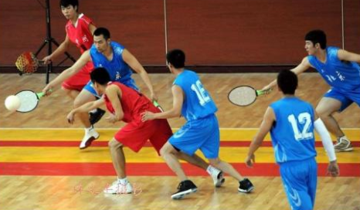

Ask and Answer
—What kind of TV show is it?
— It’s ____________.
— What do you think of it?
— I __________ it.
a sports show
can’t stand

Slide 23
Pair Work
soap opera sitcom game show news
talk show talent show sports show
A: What do you plan to watch this weekend?
B: I plan to watch... What do you think of...?
A: I love/like/don’t mind/don’t like/can’t stand...
B: Why?
A: Because...

Slide 24
Review
【计划make plans】
A: Do you want to watch the news?
B: Yes, I do. / No, I don’t.
A: What do you plan to watch tonight?
B: I plan to watch Days of Our Past.
want/plan/expect/hope to
【对某种电视节目的看法】
A: What do you think of talk shows?
B: I don’t mind them./ I can’t stand them./ I love watching them.

Slide 25
【询问及说明原因】
A: Why do you like watching the news?
B: Because I hope to find out what’s going on around the world.
【深入谈论电视节目】
A: What can you expect to learn from sitcoms?
B: You can learn some great jokes.

Slide 26


A: Do you plan to watch the news tonight?
B: Yes. I like watching the news. I watch it every night.
A: Why?
B: Because I hope to find out what’s going on around the world.
A: Do you plan to watch game shows?
B: Yes. I like watching game shows. I watch them twice a week.
A: Why?
B: Because it’s a great way to relax.

Slide 27


Listen and number the shows [1—4] in the order you hear them.
3
1
___ talent show ___ talk show
___ soccer game ___ news
4
2

Slide 28

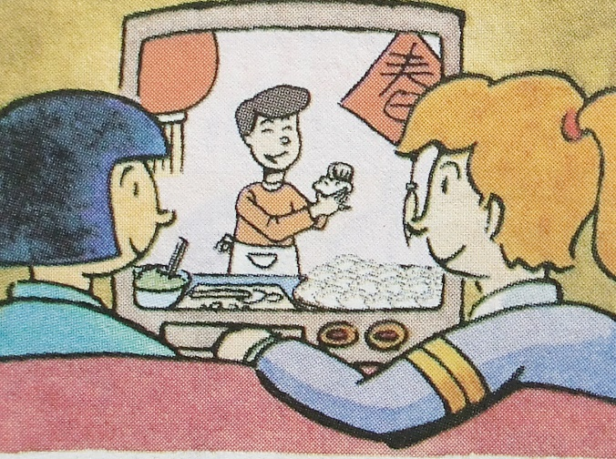
2a
Look at the picture and answer the questions.
1. What is Lin Hui doing?
2. What are they probably(可能) talking about?
She is watching sitcoms/comedy shows on TV.
They are talking about TV shows.
Lin Hui Sally

Slide 29




Listen to Lin Hui and Sally’s conversation. Number the TV shows [1-5] in the order you hear them.
____ sitcoms ____ news
____ game shows ____ talk shows
____ soap operas
1
2
4
3
5

Slide 30


Listen and complete the sentences.
1. Sally likes to watch _____________________.
2. Lin Hui thinks she can learn _____________________ from sitcoms.
3. Sally thinks _____________________ are more educational than sitcoms.
4. Sally loves _____________________. She plans to watch Days of Our Past _____________________.
the news or talk shows
some great jokes
game shows
soap operas
tonight

Slide 31
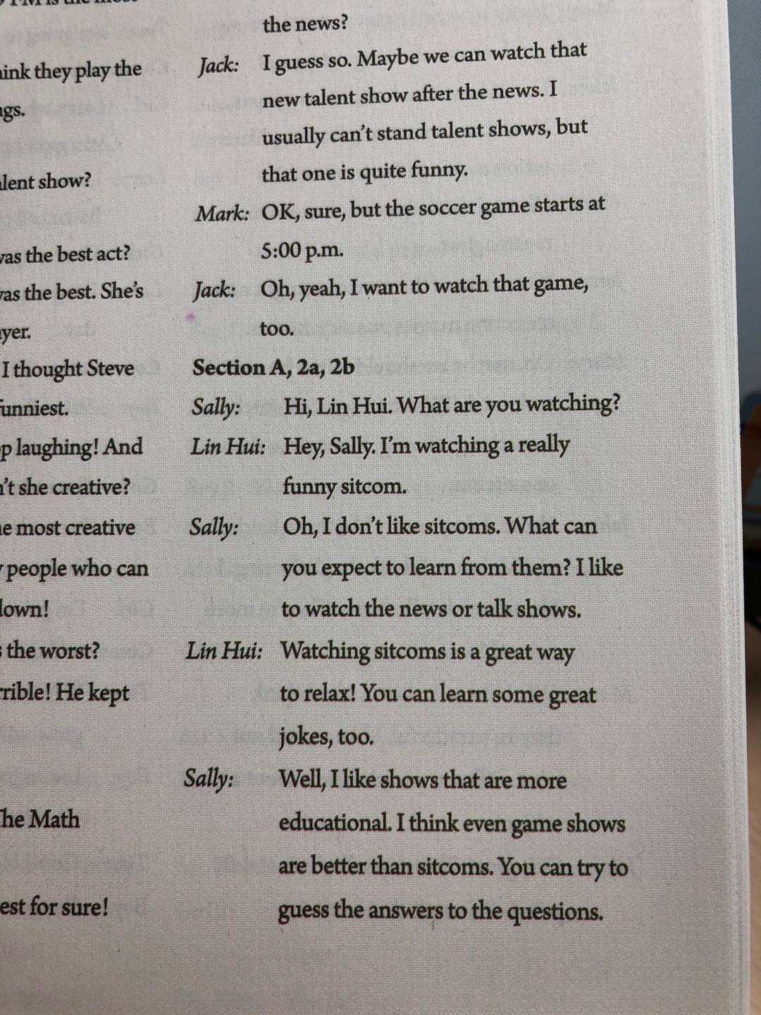
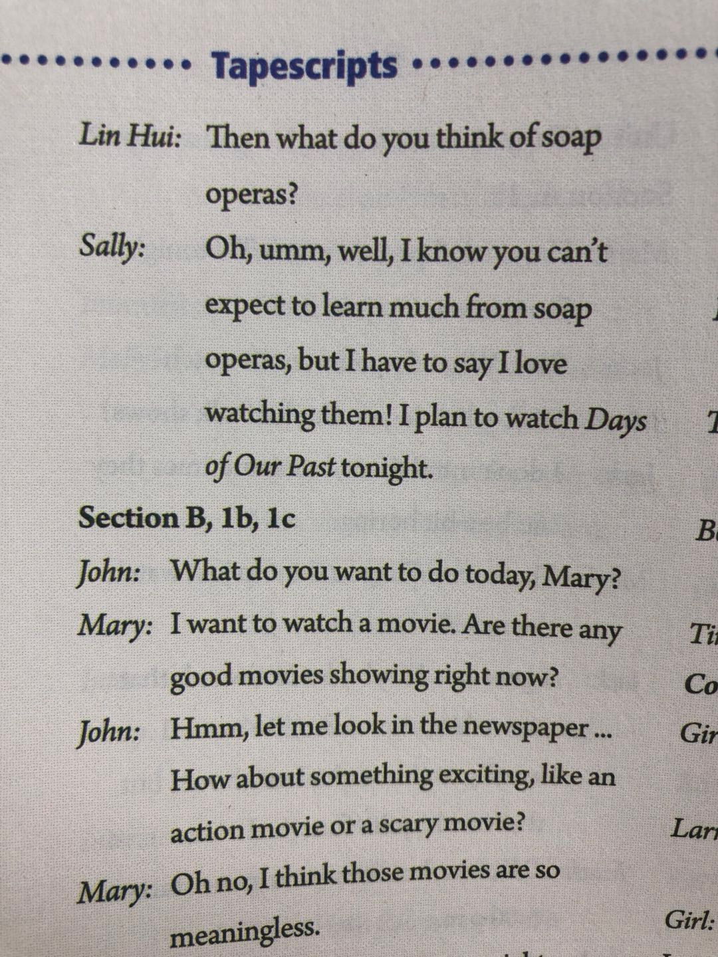

Slide 33
Ask and answer questions about the TV shows in 2a. Use information that is true for you.
A: Do you plan to watch the news tonight?
B: Yes. I like watching the news. I watch it every night.
A: Why?
B: Because I hope to find out what’s going on around the world.
A: Do you plan to watch game shows?
B: Yes. I like watching game shows. I watch them twice a week.
A: Why?
B: Because it’s a great way to relax.

Slide 34




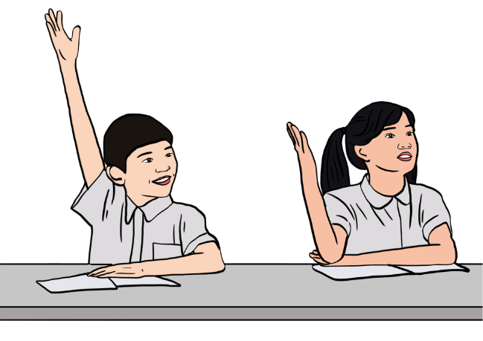



Practice the conversation. Then make your own conversations.
A: What do you want to watch?
B: What do you think of talk shows?
love
don’t like
like
don’t mind
can’t stand
A: They’re OK. I don’t mind them.
B: Then let’s watch a talk show.

Slide 35
What do/does sb. think of ...?
某人认为……怎么样？与How do/does sb. like ...?同义，询问对某事物或某人的观点或看法；
回答时可用love, like, don’t mind, don’t like, can’t stand等来表达对某事物或某人的好恶程度。
love
don’t mind
like
don’t like
can’t stand
e.g. —What do you think of soap operas?
(= How do you like soap operas?)
—I don’t mind them.

Slide 36



What do you want to watch?
What do you think of sports shows?
Oh, I can’t stand them.
Well, what about talent shows?
OK. I love watching them.

Slide 37

A: What do you want to watch?
B: What do you think of ________?
A: They’re ______. I ______________.
B: Let’s _____________.
A: What do you want to watch?
B: What ____________?
A: I ______________.
What about _______?
B: I ________.

Slide 38
Listen to Lin Hui and Sally’s conversation. Number the TV shows [1-5] in the order you hear them.
____ sitcoms ____ news
____ game shows ____ talk shows
____ soap operas
1
2
4
3
5

Slide 39
Listen again and answer the questions.
1. What does Lin Hui think of sitcoms?
2. Does Sally like sitcoms? Why?
3. What kind of TV shows does Sally like?
She thinks watching sitcoms is a great way to relax and she can learn some great jokes, too.
No, she doesn’t. Because she can’t learn from them.
She likes the news or talk shows.

Slide 40
4. What does Sally think of game shows?
5. What does Sally think of soap operas?
6. What does Sally plan to watch tonight?
She thinks it is educational. She can try to guess the answers to the questions.
adj. 有教育意义的
She can’t learn much from soap operas, but she loves watching them.
She plans to watch Days of Our Past.

Slide 41


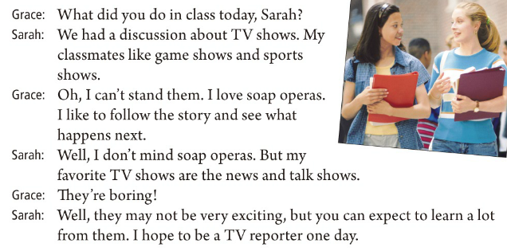
就……进行讨论
忍受
发生，碰巧。用于偶然或突发性事件
expect to do sth.期待做某事
表示过去或将来的某一天；当表示将来某一天时可与some day互换

Slide 42
就……进行讨论
忍受
发生，碰巧。用于偶然或突发性事件
expect to do sth.期待做某事
表示过去或将来的某一天；当表示将来某一天时可与some day互换

Slide 43
Fill in the blanks according to the conversation.
Sarah had a discussion about TV shows in class. Her classmates ___________ game shows and ___________, but Grace can’t ___________ them. She ___________ soap operas. She likes ___________ (follow) the story and see what ___________ next. Sarah doesn’t ___________ soap operas, but her ___________ TV shows are the news and talk shows. She thinks they may not be very exciting, but we can ___________ to learn a lot from them.
like
sports shows
stand
loves
to follow
happens
mind
favorite
expect

Slide 44

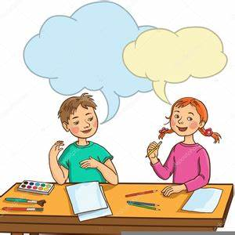
What did you do in class today, …?
We had a discussion about …

Slide 45


____________ 游戏表演；竞赛节目
talk show _____________
_____________ 从……学习……
_____________ 肥皂剧
soccer game ______________
___________ 体育节目
talent show _____________
______________ 查明；弄清
_______________________ 就……进行讨论
game show
脱口秀
learn ... from ...
soap opera
足球比赛
sports show
才艺秀
find out
have a discussion about ...

Slide 46
I don’t mind them. 我不介意它们。
I can’t stand them. 我无法忍受它们。
What do you think of talk shows?
I like to follow the story and see what happens next.

Slide 47

Ⅰ. 根据句意及括号内所给单词的提示填空。
1. A terrible fire __________ (happen) in the shopping center yesterday.
2. Is there any good __________(news) in today’s newspaper?
3. John likes different kinds of museums. He thinks they’re __________ (education) and interesting.
4. You can’t expect __________(learn) a new language in a short time.
5. Do you have any __________(plan) for the weekend?
happened
news
educational
to learn
plans

Slide 48
Ⅱ. 根据汉语意思，完成英语句子，每空一词。
1. 他们花了一年的时间环游世界。
They spent a year travelling _______ _______ _______.
2. 请帮我弄清楚会议什么时候开始。
Please help me _______ _______ what time the meeting starts.
3. 我喜欢Helen，我认为我可以从她身上学到很多。
I like Helen and I think I can _______ _______ _______ _______ _______.
around the world
find out
learn a lot
from her

Slide 49
4. Mary通过她的舞蹈赢了才艺秀。
Mary won the _________ ________ by her dancing.
5. 我很害怕，但是生活必须继续下去。
I was afraid, but life must _________ _________.
6. 我们对两种语言的不同之处进行了讨论。
We _________ _________ _________ _________ the differences between two languages.
talent show
go on
had a discussion about

Slide 50


Make a conversation by using the following expressions.
1. What do you think of …?
I like / I don’t like / don’t mind / can’t stand…
I think it’s / they’re…
2. plan to do… 3. hope to do…
4. find out … 5. can’t stand …
6. expect to do…

Slide 51


